Slide 1
Introduction
Eurozone is the economic and geographic region consisting of all the countries that incorporate and fully use the Euro as the national currency.
Eurozone countries comprised of nineteen countries.
Eurozone crisis began in 2009 after the great recession where Eurozone states financed their consumptions by taking huge amount of loans rather than saving money for production purposes.
Most of the Eurozone governments incurred more debts than necessary hence coining the name Eurozone debt crisis.

Slide 2
Causes of Financial Crises in Eurozone
Financial problems in Eurozone emerged as a result of the weaknesses in the structural set up in both the zone and individual member states that resulted in fiscal defects at national levels.
The Eurozone had a very complex structural setup that makes it challenging to offer a quick response during emergency. For instance, with its nineteen members, the decision-making process is prolonged for a unanimous agreement that must be reached during the making of a vital decision.
Poor allocation of capital and reduced pricing of risks. For instance, before the outbreak of the crisis, capital markets mispriced the dangers and also misallocated capital in the previous year hence lacking appropriate financial projections.
The Eurozone crisis was fueled by the financial crisis of 2008-2009, which engulfed the whole globe. The global turmoil overstretched into the sovereign debt crisis in several Eurozone countries at the onset of 2010.
The Eurozone financial crisis traces its roots to the world economic crisis and problems that emanated from the banking segment of the European countries, which were ignited by the bankruptcy that faced the Lehman Brothers.

Slide 3
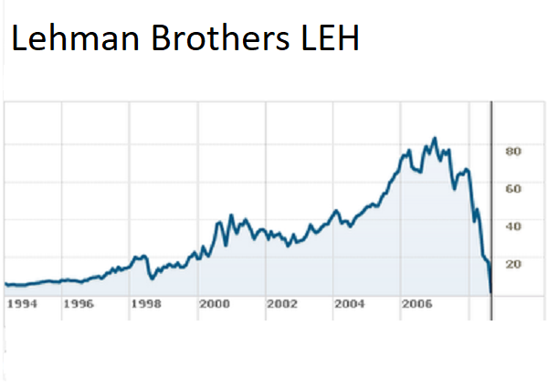
The Collapse of Lehman Brothers and the Genesis of Eurozone Crises
Notes:
The collapse of Lehman Brothers in 2008 impacted Eurozone since this bank was a great pillar of global economy. The fall of this global financial institution provoked panic throughout the entire international banking system hence destabilizing the circulation of money in the economy. Therefore, the destabilization of Eurozone’s banking system was marked by bankruptcy of Lehman Brothers that led the world into great recession.

Slide 4
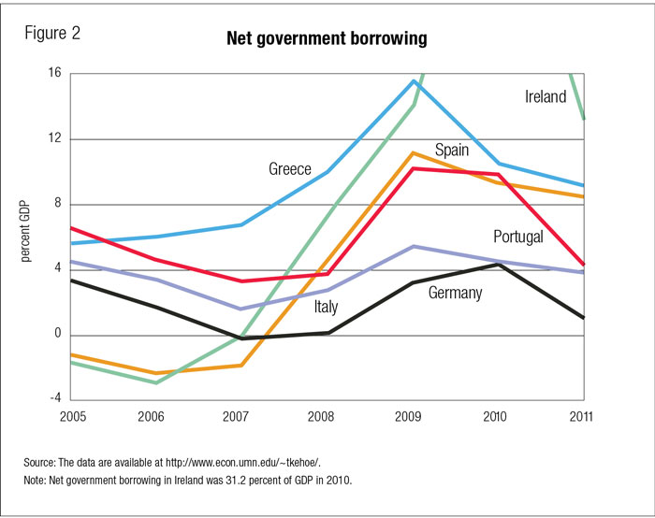
Eurozone Crises developed due to Chronic Sovereign Debt
Notes:
Sovereign debt is the total sum of a country’s borrowing that is normally issued as bonds. The Eurozone countries were involved in the sale of large quantities of bonds hence leaving these countries vulnerable to debt crises.

Slide 5
Consequences of Eurozone Crises
One of the problems is the skyrocketing public deficits and debt levels since the country had less revenue as compared to its budget.
During this negative growth, the state records less tax collection, and a small percentage of the working population leads to a reduction in income tax.
Eurozone crises increased the rates of unemployment in this region because most employers lacked adequate finances to pay for employees.

Slide 6
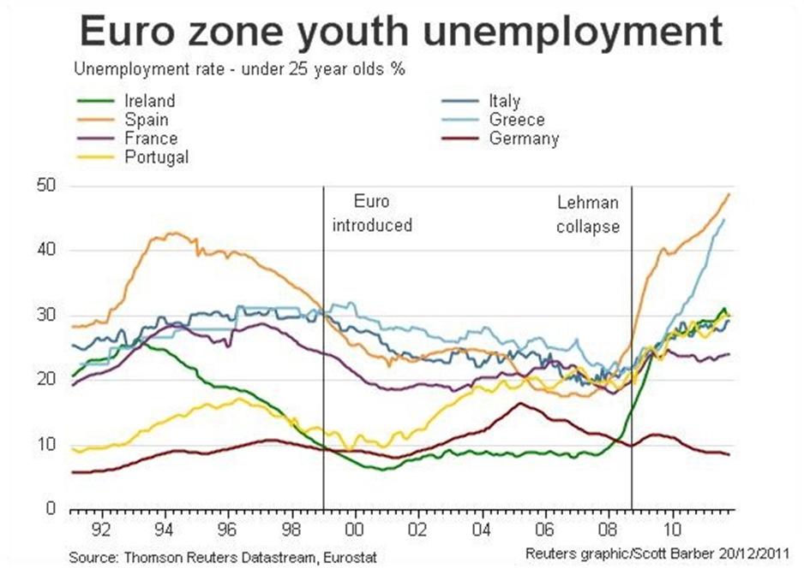
Graphic of Unemployment Rate during the Peak of Eurozone Crises
Notes:
Based on this graph, most of the youth were laid off from 2009 when Eurozone countries began experiencing financial shortages.

Slide 7
Methods of Fighting/Addressing Eurozone Crises
Tighten regulation efforts to make sure that banks have the necessary capacity to hold high levels of reserves.
Granting a banking license to the European Stabilization Mechanism to give the necessary financial help for Eurozone members facing financial difficulties.
The ECB played its part by the lowering of the interest rates and the provision of cheap loans not less than one trillion to maintain the equilibrium of money flow between the banks of Europe.

Slide 8
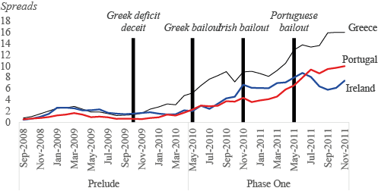
Unsuccessful Bailout Method of Fighting Eurozone Crises
Notes:
Most of the Eurozone countries initially tried to address this debt crisis by embracing bailouts. Bailout involves the act of giving financial assistance to economy to save it from collapsing. Some of the countries such as Greece, Ireland, Portugal, Spain, and Italy were in serious debt crises hence the need to assist them financially. The ECB and the IMF were the major lenders that tried to salvage the situation. Even though these countries received financial support from these lenders and other stable countries like Germany, Eurozone crises worsened thus indicating ineffectiveness of this method.

Slide 9
Conclusion
It is apparent that Eurozone’s financial goals were impacted by economic changes witnessed over time.
Countries that fail to utilize their financial resources appropriately are likely to experience debt traps.
Eurozone countries should integrate strict measures that cut across social, political, and economic systems when fighting these financial crises since a country’s economy is a reflection of all these sectors.

